Slide 1


PRESENTATION
ON
Monoalphabetic
Cipher
PRESENTED TO
Falguni Roy
ASSISTANT PROFESSOR
INSTITUTE OF INFORMATION TECHNOLOGY
NOAKHALI SCIENCE & TECHNOLOGY UNIVERSITY

Slide 2


Meet the TEAM
SANZIDA SULTANA
BKH1825010F
ANUPA DAS SHORMI
BFH1925020F
1

Slide 3
CONTENTS
Why use Monoalphabetic Cipher
What is Monoalphabetic Cipher
Procedure
ATTACK POSSIBLE ON MONOALPHABETIC CIPHERS
Weakness of Monoalphabetic Cipher
2

Slide 4

Why Need Monoalphabetic Cipher
In Caesar Cipher there are 26 possible keys possible to encrypt our plaintext. Since 26 possible keys are there, it is very easy to break caeser cipher using BRUIT-FORCE attack.
BRUIT-FORCE attack : The attacker tries every possible key on a piece of ciphertext until an intelligible translation into plaintext is obtained. On average, half of all possible keys must be tried to achieve success.
In monoalphabetic cipher the possible key space is very large.
That is, 26!=4*(10)^26.
So in order to enhance the security of encryption monoalphabetic ciphers are needed.
3

Slide 5
There are basically two types of cipher
Substitution cipher
Transposition cipher
Substitution is a technique in which each letter
or bit of the plaintext is substitute or replaced
by some other letter,number or symbol to produce
cipher text.
For example:ABC -> XYZ
Substitution Cipher
4

Slide 6
Types of substitution technique:
Caesar Cipher
Monoalphabetic Cipher
Polyalphabetic Cipher
Substitution Cipher
Playfair Cipher
One Time Pad Cipher
Hill Cipher
5

Slide 7
What is MonoAlphabetic Cipher
3
2
It includes additive, multiplicative, affine and monoalphabetic substitution cipher.
It is less complex than Polyalphabetic Cipher.
1
The relationship between a character in the plain text and the characters in the cipher text is one-to-one.
Each alphabetic character of plain text is mapped onto a unique alphabetic character of a cipher text.
Monoalphabetic cipher is a substitution cipher in which for a given key, the cipher alphabet for each plain alphabet is fixed throughout the encryption process.
For example, if ‘A’ is encrypted as ‘D’, for any number of occurrence in that plaintext, ‘A’ will always get encrypted to ‘D’.
6

Slide 8
PROCeDURE
Here this table showing maping between each pain text character and the correspondings cipher text Character.
PLAIN TEXT
a | b | c | d | e | f
g | h | i | j | k | l | m | n | o | p
q | r | s | t | u | v | w | x | y | z
CIPHER TEXT
D | E | A | B | C | U
W | V | F | Y | Z | X | G | T | H | S
R | I | J | Q | P | K | L | O | N | M
Plain text: hello world
Cipher text: VCXXH LHIXB (Here both occurrences of ‘L’ are substituted by X in cipher text.)
7

Slide 9
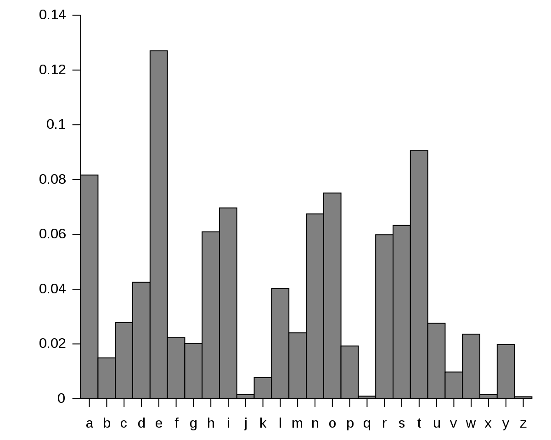
ATTACK POSSIBLE ON MONOALPHABETIC CIPHERS
At the Attacker point of view it is easy for them to break the Monoalphabetic Cipher because attacker, cryptanalyst knows the Relative Frequency of Letters in English Text.
Relative Frequency of Letters in English Text
8

Slide 10
The most common first letter in a word on order of frequency
T, O, A, W, B, C, D, S, F, M, R, H, I, Y, E, G, L, N, O, U, J, K
The most common second letter in a word of frequency
H, O, E, A, U, N, R, T
The most common third letter in a word in order of frequency
E, S, A, R, N, I
More than half of all words ends with E,T,D,S
The most common diagraph in order of frequency
TH, HE, AN, ER, ON, RE, ED, ND, HA, AT, ES, OF, NT, EA, TI, TO, IO, LE, IS, OU, AR, AS, DE, RT, VE
The most trigraph in order of frequency
THE, AND, THA, ENT, ION, TIO, FOR, NDE, HAS, NCE, TIS, OFT, MEN
The most double letter in order of frequency
SS, EE, TT, LL, MM, OO
9

Slide 11
The ciphertext to be solved is:
GFS WMY OG LGDVS MF SFNKYHOSU ESLLMRS, PC WS BFGW POL DMFRQMRS, PL OG CPFU M UPCCSKSFO HDMPFOSXO GC OIS LMES DMFRQMRS DGFR SFGQRI OG CPDD GFS LISSO GK LG, MFU OISF WS NGQFO OIS GNNQKKSFNSL GC SMNI DSOOSK. WS NMDD OIS EGLO CKSJQSFODY GNNQKKPFR DSOOSK OIS 'CPKLO', OIS FSXO EGLO GNNQKKPFR DSOOSK OIS 'LSNGFU' OIS CGDDGWPFR EGLO GNNQKKPFR DSOOSK OIS 'OIPKU', MFU LG GF, QFOPD WS MNNGQFO CGK MDD OIS UPCCSKSFO DSOOSKL PF OIS HDMPFOSXO LMEHDS. OISF WS DGGB MO OIS NPHISK OSXO WS WMFO OG LGDVS MFU WS MDLG NDMLLPCY POL LYEAGDL. WS CPFU OIS EGLO GNNQKKPFR LYEAGD MFU NIMFRS PO OG OIS CGKE GC OIS 'CPKLO' DSOOSK GC OIS HDMPFOSXO LMEHDS, OIS FSXO EGLO NGEEGF LYEAGD PL NIMFRSU OG OIS CGKE GC OIS 'LSNGFU' DSOOSK, MFU OIS CGDDGWPFR EGLO NGEEGF LYEAGD PL NIMFRSU OG OIS CGKE GC OIS 'OIPKU' DSOOSK, MFU LG GF, QFOPD WS MNNGQFO CGK MDD LYEAGDL GC OIS NKYHOGRKME WS WMFO OG LGDVS.
10

Slide 12
The first step is to find the frequency of all the letters appearing in the intercept .For this intercept we get
the values given in the table below:
Cipher Text
A | B | C | D | E | F | G | H | I | J
5 | 2 | 26 | 42 | 23 | 51 | 67 | 8 | 33 | 1
K | L | M | N | O | P | Q | R | S | T
35 | 39 | 35 | 29 | 85 | 30 | 14 | 17 | 88 | 0
U | V | W | X | Y | Z
17 | 3 | 16 | 6 | 10 | 0
Frequency
This below frequencies ordered from most common to least to make comparisons easier:
Cipher Text
S | O | G | F | D | L | K | M | I | P
88 | 85 | 67 | 51 | 42 | 39 | 35 | 35 | 33 | 30
N | C | E | R | U | W | Q | Y | H | X
29 | 26 | 23 | 17 | 17 | 16 | 14 | 10 | 8 | 6
A | V | B | J | T | Z
5 | 3 | 2 | 1 | 0 | 0
Frequency
Now that we have all the frequencies of ciphertext letters, we can start to make some substitutions. We see that the most common ciphertext letter is "S", closely followed by "O". From the chart and table above, we can guess that these two letters represent "e" and "t" respectively, and after making these substitutions we get:
11

Slide 14
GFe WMY tG LGDVe MF eFNKYHteU EeLLMRe, PC We BFGW PtL DMFRQMRe, PL tG CPFU M UPCCeKeFt HDMPFteXt GC tIe LMEe DMFRQMRe DGFR eFGQRI tG CPDD GFe LIeet GK LG, MFU tIeF We NGQFt tIe GNNQKKeFNeL GC eMNI DetteK. We NMDD tIe EGLt CKeJQeFtDY GNNQKKPFR DetteK tIe 'CPKLt', tIe FeXt EGLt GNNQKKPFR DetteK tIe 'LeNGFU' tIe CGDDGWPFR EGLt GNNQKKPFR DetteK tIe 'tIPKU', MFU LG GF, QFtPD We MNNGQFt CGK MDD tIe UPCCeKeFt DetteKL PF tIe HDMPFteXt LMEHDe. tIeF We DGGB Mt tIe NPHIeK teXt We WMFt tG LGDVe MFU We MDLG NDMLLPCY PtL LYEAGDL. We CPFU tIe EGLt GNNQKKPFR LYEAGD MFU NIMFRe Pt tG tIe CGKE GC tIe 'CPKLt' DetteK GC tIe HDMPFteXt LMEHDe, tIe FeXt EGLt NGEEGF LYEAGD PL NIMFReU tG tIe CGKE GC tIe 'LeNGFU' DetteK, MFU tIe CGDDGWPFR EGLt NGEEGF LYEAGD PL NIMFReU tG tIe CGKE GC tIe 'tIPKU' DetteK, MFU LG GF, QFtPD We MNNGQFt CGK MDD LYEAGDL GC tIe NKYHtGRKME We WMFt tG LGDVe.
We now notice that the word "tIe" is appearing frequently in the passage. In English, the most common 3 letter word is "the" and this fits with what we have already done, which suggests that "I" should be decrypted to "h".
Also, by looking at the frequencies again, we see the next most common letter is "G", which is probably one of "a", "i" or "o". We see that the third word is "tG", and the only one of these options that makes sense is "to", so we guess "G" is "o".
12

Slide 15
oFe WMY to LoDVe MF eFNKYHteU EeLLMRe, PC We BFoW PtL DMFRQMRe, PL to CPFU M UPCCeKeFt HDMPFteXt oC the LMEe DMFRQMRe DoFR eFoQRh to CPDD oFe Lheet oK Lo, MFU theF We NoQFt the oNNQKKeFNeL oC eMNh DetteK. We NMDD the EoLt CKeJQeFtDY oNNQKKPFR DetteK the 'CPKLt', the FeXt EoLt oNNQKKPFR DetteK the 'LeNoFU' the CoDDoWPFR EoLt oNNQKKPFR DetteK the 'thPKU', MFU Lo oF, QFtPD We MNNoQFt CoK MDD the UPCCeKeFt DetteKL PF the HDMPFteXt LMEHDe. theF We DooB Mt the NPHheK teXt We WMFt to LoDVe MFU We MDLo NDMLLPCY PtL LYEAoDL. We CPFU the EoLt oNNQKKPFR LYEAoD MFU NhMFRe Pt to the CoKE oC the 'CPKLt' DetteK oC the HDMPFteXt LMEHDe, the FeXt EoLt NoEEoF LYEAoD PL NhMFReU to the CoKE oC the 'LeNoFU' DetteK, MFU the CoDDoWPFR EoLt NoEEoF LYEAoD PL NhMFReU to the CoKE oC the 'thPKU' DetteK, MFU Lo oF, QFtPD We MNNoQFt CoK MDD LYEAoDL oC the NKYHtoRKME We WMFt to LoDVe.
The first word is now "oFe", which when considered with the appearance of "theF", leads us to the conclusion that "F" is "n". This also fits in with the frequencies of both letters in the tables.
In the third line we see the word "Lheet", which is most likely to be "sheet", and so we replace "L" with "s". Again, the frequencis of these two letters are about right.
one WMY to soDVe Mn enNKYHteU EessMRe, PC We BnoW Pts DMnRQMRe, Ps to CPnU M UPCCeKent HDMPnteXt oC the sMEe DMnRQMRe DonR enoQRh to CPDD one sheet oK so, MnU then We NoQnt the oNNQKKenNes oC eMNh DetteK. We NMDD the Eost CKeJQentDY oNNQKKPnR DetteK the 'CPKst', the neXt Eost oNNQKKPnR DetteK the 'seNonU' the CoDDoWPnR Eost oNNQKKPnR DetteK the 'thPKU', MnU so on, QntPD We MNNoQnt CoK MDD the UPCCeKent DetteKs Pn the HDMPnteXt sMEHDe. then We DooB Mt the NPHheK teXt We WMnt to soDVe MnU We MDso NDMssPCY Pts sYEAoDs. We CPnU the Eost oNNQKKPnR sYEAoD MnU NhMnRe Pt to the CoKE oC the 'CPKst' DetteK oC the HDMPnteXt sMEHDe, the neXt Eost NoEEon sYEAoD Ps NhMnReU to the CoKE oC the 'seNonU' DetteK, MnU the CoDDoWPnR Eost NoEEon sYEAoD Ps NhMnReU to the CoKE oC the 'thPKU' DetteK, MnU so on, QntPD We MNNoQnt CoK MDD sYEAoDs oC the NKYHtoRKME We WMnt to soDVe.
13

Slide 16
We see the world "soDVe", which could be "solve", implying the transformations of "D" and "V" to "l" and "v" respectively.
In the second line we now have the phrase "one sheet oK so", which suggests that "K" is "r".
one WMY to solve Mn enNrYHteU EessMRe, PC We BnoW Pts lMnRQMRe, Ps to CPnU M UPCCerent HlMPnteXt oC the sMEe lMnRQMRe lonR enoQRh to CPll one sheet or so, MnU then We NoQnt the oNNQrrenNes oC eMNh letter. We NMll the Eost CreJQentlY oNNQrrPnR letter the 'CPrst', the neXt Eost oNNQrrPnR letter the 'seNonU' the ColloWPnR Eost oNNQrrPnR letter the 'thPrU', MnU so on, QntPl We MNNoQnt Cor Mll the UPCCerent letters Pn the HlMPnteXt sMEHle. then We looB Mt the NPHher teXt We WMnt to solve MnU We Mlso NlMssPCY Pts sYEAols. We CPnU the Eost oNNQrrPnR sYEAol MnU NhMnRe Pt to the CorE oC the 'CPrst' letter oC the HlMPnteXt sMEHle, the neXt Eost NoEEon sYEAol Ps NhMnReU to the CorE oC the 'seNonU' letter, MnU the ColloWPnR Eost NoEEon sYEAol Ps NhMnReU to the CorE oC the 'thPrU' letter, MnU so on, QntPl We MNNoQnt Cor Mll sYEAols oC the NrYHtoRrME We WMnt to solve.
In the middle of the second line we have the word "enoQRh", which is likely to be "enough", and so we have the transformations "Q" and "R" to "u" and "g" respectively.
14

Slide 17
one WMY to solve Mn enNrYHteU EessMge, PC We BnoW Pts lMnguMge, Ps to CPnU M UPCCerent HlMPnteXt oC the sMEe lMnguMge long enough to CPll one sheet or so, MnU then We Nount the oNNurrenNes oC eMNh letter. We NMll the Eost CreJuentlY oNNurrPng letter the 'CPrst', the neXt Eost oNNurrPng letter the 'seNonU' the ColloWPng Eost oNNurrPng letter the 'thPrU', MnU so on, untPl We MNNount Cor Mll the UPCCerent letters Pn the HlMPnteXt sMEHle. then We looB Mt the NPHher teXt We WMnt to solve MnU We Mlso NlMssPCY Pts sYEAols. We CPnU the Eost oNNurrPng sYEAol MnU NhMnge Pt to the CorE oC the 'CPrst' letter oC the HlMPnteXt sMEHle, the neXt Eost NoEEon sYEAol Ps NhMngeU to the CorE oC the 'seNonU' letter, MnU the ColloWPng Eost NoEEon sYEAol Ps NhMngeU to the CorE oC the 'thPrU' letter, MnU so on, untPl We MNNount Cor Mll sYEAols oC the NrYHtogrME We WMnt to solve.
We have the word "Nount" which is could be "count" and "EessMge" which is likely to be "message", giving us that "N", "E" and "M" and "c", "m" and "a".
one WaY to solve an encrYHteU message, PC We BnoW Pts language, Ps to CPnU a UPCCerent HlaPnteXt oC the same language long enough to CPll one sheet or so, anU then We count the occurrences oC each letter. We call the most CreJuentlY occurrPng letter the 'CPrst', the neXt most occurrPng letter the 'seconU' the ColloWPng most occurrPng letter the 'thPrU', anU so on, untPl We account Cor all the UPCCerent letters Pn the HlaPnteXt samHle. then We looB at the cPHher teXt We Want to solve anU We also classPCY Pts sYmAols. We CPnU the most occurrPng sYmAol anU change Pt to the Corm oC the 'CPrst' letter oC the HlaPnteXt samHle, the neXt most common sYmAol Ps changeU to the Corm oC the 'seconU' letter, anU the ColloWPng most common sYmAol Ps changeU to the Corm oC the 'thPrU' letter, anU so on, untPl We account Cor all sYmAols oC the crYHtogram We Want to solve.
15

Slide 18
It is likely that "W"->"w", "X"->"x", "Y"->"y" and "Z"->"z".
The word "occurrPng" is clearly meant to read "occurring", and it is likely that "sYmAol" is "symbol".
one way to solve an encryHteU message, iC we Bnow its language, is to CinU a UiCCerent Hlaintext oC the same language long enough to Cill one sheet or so, anU then we count the occurrences oC each letter. we call the most CreJuently occurring letter the 'Cirst', the next most occurring letter the 'seconU' the Collowing most occurring letter the 'thirU', anU so on, until we account Cor all the UiCCerent letters in the Hlaintext samHle. then we looB at the ciHher text we want to solve anU we also classiCy its symbols. we CinU the most occurring symbol anU change it to the Corm oC the 'Cirst' letter oC the Hlaintext samHle, the next most common symbol is changeU to the Corm oC the 'seconU' letter, anU the Collowing most common symbol is changeU to the Corm oC the 'thirU' letter, anU so on, until we account Cor all symbols oC the cryHtogram we want to solve.
We have the word “encryHteu" which is could be “enctypted" and “Bnow" which is likely to be “know", giving us that "C" is "f", "B" is "k", "U" is "d", "J" is "q" and "H" is "p".
one way to solve an encrypted message, if we know its language, is to find a different plaintext of the same language long enough to fill one sheet or so, and then we count the occurrences of each letter. we call the most frequently occurring letter the 'first', the next most occurring letter the 'second' the following most occurring letter the 'third', and so on, until we account for all the different letters in the plaintext sample. then we look at the cipher text we want to solve and we also classify its symbols. we find the most occurring symbol and change it to the form of the 'first' letter of the plaintext sample, the next most common symbol is changed to the form of the 'second' letter, and the following most common symbol is changed to the form of the 'third' letter, and so on, until we account for all symbols of the cryptogram we want to solve.
16

Slide 19
WEAKNESSES
1
If more repetition occur then attacker can easily guess the plaintext.
2
Intruder can use statistical attack based on the frequency of characters .
3
Cipher does not change frequency of characters.
4
Monoalphabetic ciphers are not that strong as compared to polyalphabetic cipher.
5
Cryptanalysis is easy.
17

Slide 20

18

